Slide 1
W-MeMo
Wireless Metering and Monitoring
for
Smart Water Grids
GTTI for the Future - Conference on Knowledge Capital
May 14, 2013 - CONFINDUSTRIA FIRENZE, Florence, Italy

Slide 2
Company
Founded in September 2012 as a Spin-Off of the Università Politecnica delle Marche – Ancona (ITALY)
Founding members:
Two Assistant Professors in the Information and Communication Technology (ICT) field
A PhD student in Electronic Engineering
A strategic marketing expert, with experience in the energy field
ArieLab Srl, R&D company in TLC (born as UNIVPM spinoff in 2004)
A Full Professor in Circuit Theory, with strong expertise in Digital Signal Processing
Università Politecnica delle Marche

Slide 3
Milestones
In November 2011, L. Gabrielli, S. Squartini and S. Spinsante are awarded a 30k€ research grant from the «Working Capital 2011» initiative, sponsored by TelecomItalia SpA and PNI, for the project: FluidEnergy – Energy Harvesting Wireless Sensor Networks.
The same team, in March 2012, receives a 50k€ seed fund as the winner of the «E-Capital 2011 Business Idea Competition», sponsored by Fondazione Marche and ISTAO.
In September 2012, DowSee Srl is established.
DowSee Srl is among the winners of the 2012 Italia Camp Initiative «La tua idea per il Paese» (Verona, Italy, November 2012), and passed the first-level selection of ENEL Lab Competition.

Slide 4
Team
Stefano Squartini
Leonardo Gabrielli
Susanna Spinsante
DowSee Board of Directors
Mirco Pizzichini, Matteo Mencarelli
Assistant Researchers at UNIVPM
(1 year research scholarships co-funded by DowSee Srl)

Slide 5
Market Analysis: Need and Solution
The Water Leakage Problem (ISTAT 2008)
The global water sector is facing a growing number of challenges and needs. Water scarcity, pollution increase, world demographic and industrial growth are increasing the necessity to preserve this vital resource.
Losses due to seepage and leaky pipes both in supply, irrigation and power generation applications reach almost 50% in our Country (ISTAT 2008), causing a Non Revenue Water estimated economic damage of 3 EUR BN per year.
Moreover several National Legislations, driven by European Directives, are starting to request mandatory Smart Metering devices to Utilities, in order to increase consumption awareness and stimulate saving by end users.
Recent advancements of the electronics and telecommunication industry in the field of wireless sensor networks, suggest today new and more effective methods for water saving and optimization.
 | Water entering | Leakage
Region | network (m³/head) | rate (%)
Piemonte | 132 | 47
Valle d'Aosta | 182 | 49
Lombardia | 146 | 27
Trentino A.A. | 147 | 27
Veneto | 127 | 43
Friuli V.G. | 162 | 68
Liguria | 148 | 39
Emilia-Romagna | 110 | 32
Toscana | 122 | 38
Umbria | 101 | 48
Marche | 102 | 34
Lazio | 172 | 55
Avbruzzo | 162 | 77
Molise | 159 | 78
Campania | 131 | 63
Puglia | 119 | 87
Basilicata | 140 | 49
Calabria | 148 | 50
Sicilia | 124 | 54
Sardegna | 162 | 85
Average | 136 | 47
DowSee W-MeMo Solution
Scalable Wireless Sensor Network for Water Grid Metering and Monitoring
Based on self-powered sensor nodes
Offers a real time control service over the internet, to Utilities and their customers

Slide 6
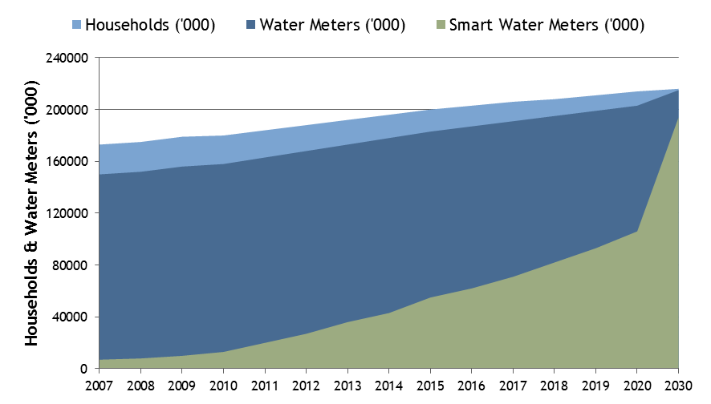
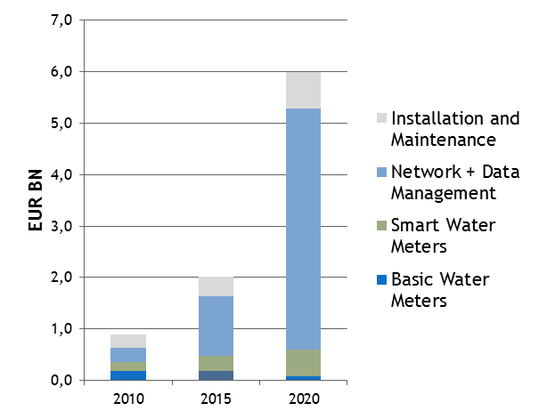
Market Analysis: Size and Forecast
EUROPE: Smart Water Metering Penetration Stock
EUROPE: Yearly Market Size and Forecast
Source: Frost & Sullivan and internal elaborations
Market
Revenue
€ 1,9 BN
Market
Revenue
€ 6,0 BN
Market
Revenue
€ 0,9 BN
In the first years DowSee products and solutions will be mainly addressed to Italy and neighboring European Countries.
According to a recent study by Frost & Sullivan (“Smart Water Metering Mega Trend Roadmap”), the total European market for products and services related to water grid metering was worth 0,9 EUR BN in 2010.
The value was roughly divided into 3 equal parts: products (smart or traditional meters), installation and maintenance services, network and data management infrastructure (including billing and data analytics).
Frost & Sullivan forecasts total market to grow up to 6,0 EUR BN by 2020, with the largest increase (more than 4 EUR BN) expected in the hardware network infrastructure and data management segment, opening a wide space for new ICT specialized companies to enter the market.

Slide 7
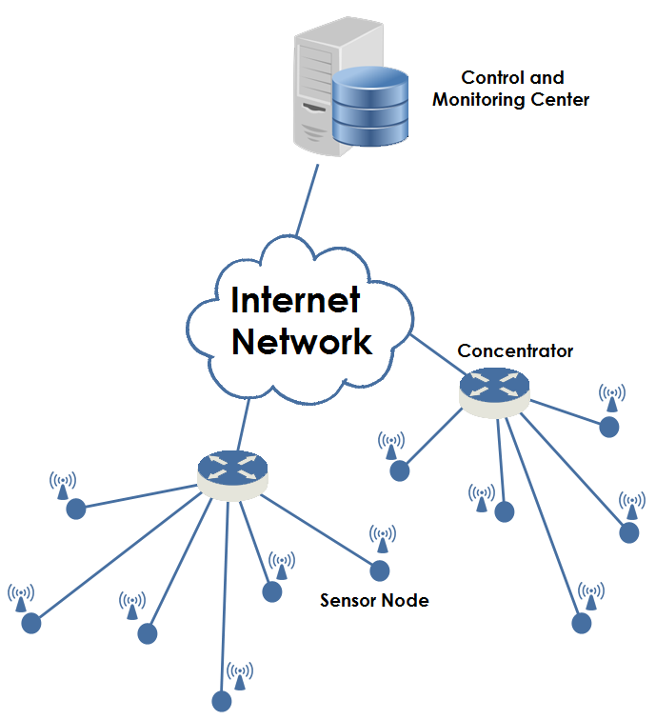
Our system
W-MeMo is a sensor network based system (WSN - Wireless Sensor Network) for the real-time monitoring & metering of water grids
W-MeMo nodes located along water pipes are able to process the data collected by specific sensors, and to send them to a remote concentrator, on a wireless link
Each concentrator collects data delivered by W-MeMo nodes and relays them to a control facility
Proper advanced data analysis and processing techniques enable an improved management of the water grid, with possible anomalies automatically detected

Slide 8
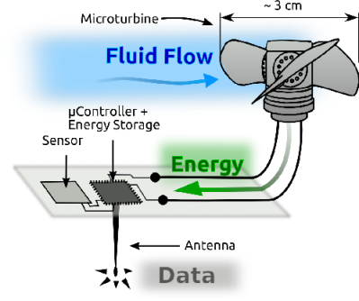
W-MeMo Node
Main components of the W-MeMo node design are related to sensing – power supply – radio communication
W-MeMo node may host several sensors, to collect data about water quality and consumption
W-MeMo is a low-power device* (estimated battery lifetime ≥ 10 years)
Radio data communication compliant with the Wireless M-Bus @ 169 MHz protocol (~ 2 km LOS maximum transmission distance)
*At present, we are developing an Energy Harvesting module that exploits the kinetic energy of the water flow within pipes to feed the node, for a fully autonomous and sustainable solution

Slide 9
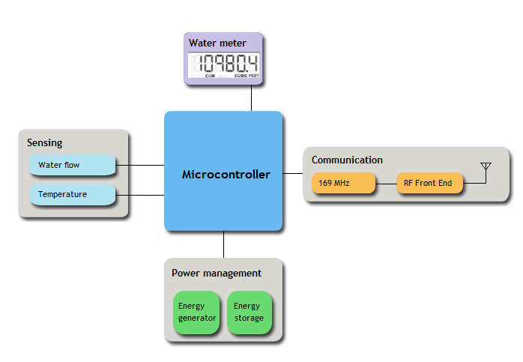
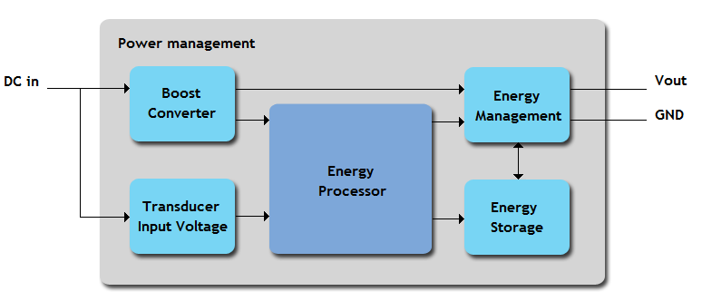
Technology Description: W-MeMo System
W-MeMo Node
System integration: metering & leakage detection
Operative mode: wireless M-Bus
Radio frequency: 169 MHz
Data transmission frequency: programmable
Encryption mode: AES-128
Power supply: self-powered
Efficient power management system
Network Architecture
Full monitoring system
Local Area Network operating with Wireless M-Bus
Master node acting as a wM-Bus/GPRS Gateway
Cloud computing system for data management
Web portal to easily access data

Slide 10
Technology Description: Focus on Innovation
Power-Supply
Fully self-powered sensor node (Energy Harvesting)
Power supply obtained from water kinetic energy
Efficient usage of available energy through a scheduling algorithm
Wireless Sensor Network
Wireless M-Bus radio protocol
Long communication distance covered between meter and concentrator
More than 1000 meters can be handled by a single concentrator module
Scalable and reconfigurable
Offered services
Adavanced Metering Infrastructure
Centralized data mining management
Real-time information for customer about water cost, consumption and grid status
Proactive action on big damages due to serious leakages (dynamic management of in-pipes pressure)

Slide 11
Data Management
Once collected, data are received at the control and monitoring center, they are processed by means of advanced techniques based on computational intelligence
Algorithms applied to process data help the utility to get information about water consumptions, and to plan and operate proper actions for plant maintenance, such as reducing the water flow in pipes, dynamically adjusting water pressure, and controlling electrovalves in the plant
As soon as the W-MeMo system detects a leakage, the software engine generates and sends alarm messages, which provide information about failure location and gravity, thus supporting human operators in taking proper countermeasures

Slide 12
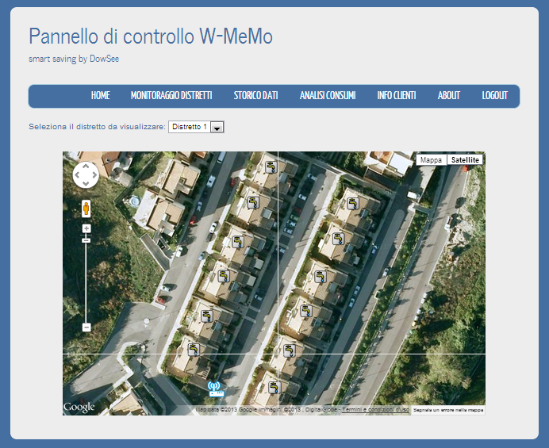
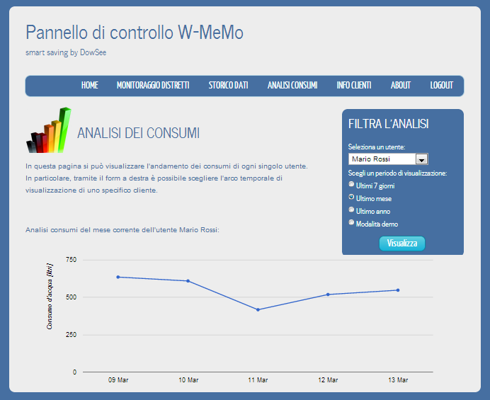
Web Platform
Data are stored and managed in a cloud-based infrastructure, consequently they may be accessed by any connected device (either mobile and fixed)
The Utility may check in real time the current situation of the water plant (e.g. water level, water pressure, global consumptions in a district) by selecting the area of interest, on an interactive map showing the water distribution system

Slide 13
Advantages
Fast detection and localization of leaks and failures
Real time management of flow and pressure: depending on users’ consumption, flow and pressure may be dynamically adjusted to limit structural stress of the plant
Strong reduction of costs related to personnel movements and training, requested by periodic manual monitoring campaigns
Enabling an autonomous remote monitoring of the plant, which integrates control processes (e.g. SCADA) at the output of water plant sectors
Reduction of maintenance costs
Increase of user’s awareness about water preservation and usage

Slide 14
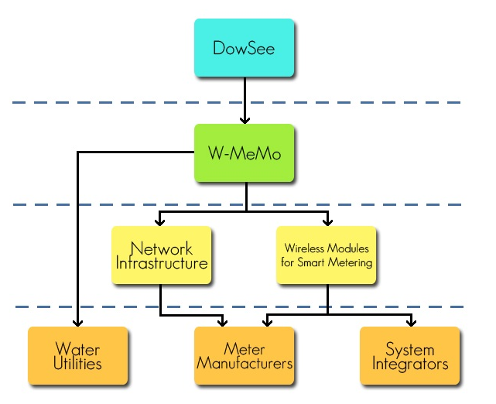
Business Model: Route to Market
DowSee goal is to provide a fully ICT smart metering system
Distribution
In easily accessible markets, W-MeMo is directly sold to water utilities, in a complete product & service solution, consisting of W-MeMo RF modules, gateways, installation, network deployment and web application.
In other markets, W-MeMo hardware components are separately sold to Meters Manufacturers and System Integrators, which are left the possibility to perform independently the installation and the implementation of the ICT infrastructure.
Supply
Hardware: Global semiconductor design & manufacturing companies that provide interesting and low-cost solutions (first W-MeMo prototype was realized with Texas Instrument® integrated circuits).
Water meter & leakage detection: meter manufactures and companies that product flow sensors.
Promotion
Taking part to trade fairs, national meetings, international conferences, publication of scientific articles.
Sponsoring events in the territories which have bought or intend to buy our technology.
Building a network of contacts among specialized engineering and construction companies.
Using targeted advertising (specialized magazines).
Growing public awareness, local and national institutions’ interest.

Slide 15
Current Activities
First prototype W-MeMo node + concentrator has been completed, together with preliminary version of the web platform and application, needed to store and access the collected data
Development of an Energy Harvesting technology suitable for the W-MeMo hardware platform + suitable energy and tasks management algorithms
Design and implementation of the W-MeMo architecture (wM-Bus stack completion, channel access strategies, node management policies at the concentrator)
Design and implementation of several communication interfaces for the concentrator (besides wM-Bus/GPRS, Wi-Fi, PLC)
Design of a remote management protocol to dynamically and remotely configure the network from the Utility control center
First market campaign to contact local Utilities, and companies potentially interested to B2B partnerships
Scouting of opportunities for Industrial R&D funded Projects
Scouting of “parallel” potential markets (heat metering, power & energy field)

Slide 16
Video

Slide 17
Publications
M. Mencarelli, M. Pizzichini, L. Gabrielli, S. Spinsante, S. Squartini. “Self-Powered Sensor Networks for Water Grids: Challenges and Preliminary Evaluations”, Cyber Journals: Multidisciplinary Journals in Science and Technology, Journal of Selected Areas in Telecommunications (JSAT), October Edition, 2012
S. Squartini, L. Gabrielli, M. Mencarelli, M. Pizzichini, S. Spinsante, F. Piazza, “Wireless M-Bus Sensor Nodes in Smart Water Grids: the Energy Issue,” Proc. Of International Conference on Intelligent Control and Information Processing (ICICIP 2013), Beijing, China, June 9-11, 2013.
S. Spinsante, M. Pizzichini, M. Mencarelli, S. Squartini, E. Gambi, “Evaluation of the Wireless M-Bus Standard for Future Smart Water Grids,” Proc. Of IEEE International Wireless Communications and Mobile Computing Conference (IWCMC) 2013, July 1-5, 2013, Cagliari, Sardinia, Italy.

Slide 18
Contact us
DowSee Srl
Via E. Natali 14, 60044
Fabriano (AN) - ITALY
Web: www.dowsee.it
E-mail: info@dowsee.it
Phone: +39 333-4673335 (L. Gabrielli)
+39 392-2928614 (S. Spinsante)
+39 328-8413154 (S. Squartini)

Slide 19
W-MeMo by DowSee
Thanks for your
attention
Susanna Spinsante, DowSee Srl

