Slide 1
Add a sense to your plant™
Dott. Ing. Manuel Crotti – Fluidsens s.r.l. FLUIDMEC group S.p.A.
Notes:
This template can be used as a starter file for presenting training materials in a group setting.
Sections
Sections can help to organize your slides or facilitate collaboration between multiple authors. On the Home tab under Slides, click Section, and then click Add Section.
Notes
Use the Notes pane for delivery notes or to provide additional details for the audience. You can see these notes in Presenter View during your presentation.
Keep in mind the font size (important for accessibility, visibility, videotaping, and online production)
Coordinated colors
Pay particular attention to the graphs, charts, and text boxes.
Consider that attendees will print in black and white or grayscale. Run a test print to make sure your colors work when printed in pure black and white and grayscale.
Graphics, tables, and graphs
Keep it simple: If possible, use consistent, non-distracting styles and colors.
Label all graphs and tables.

Slide 2
Summary
The company
The product: FLUIDSENS™ architecture
The lesson

Slide 3
FLUIDSENS s.r.l. – who we are
A company part of the FLUIDMEC s.p.a. group
Incorporated in May, 2011
Core group: complementary experience
Hydraulics production
Hydraulics components
Software engineering
Automation and electrical engineering
Main target: bring modern Information and Communication Technology (ICT) to production plants

Slide 4
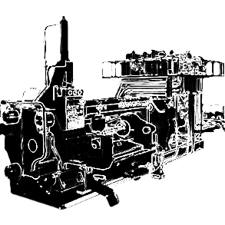
Monitoring (existing) production plants: the problem
No pervasive sensory data is available
Faults often require multiple hours/days stops: economic loss
Difficult to perform just-in-time preventive maintenance (lack of real time data)
Cycle optimization is next to impossible, especially as the machines age
Retro-fitting existing plants with standard technology is often too expensive

Slide 5
Introducing the FLUIDSENS™ architecture
A scalable, low-cost, yet technologically advanced platform for pervasive monitoring of existing (large scale) industrial production plants
Engineered to be retrofitted to any existing plant machinery
Scales to thousands of sensors
Pluggable data transmission modules
Wireless (worldwide compatibility)
Wired
Sensor-independent: can monitor any sensor, anywhere in the plant, either existing or that come with the architecture itself
Pressure
Temperature or moving parts, fluids, air, etc.
Power
Etc.
Hierarchical architecture: can be fitted to any plant size
Custom designed HW and SW, engineered for rough plant environments

Slide 6
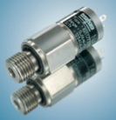
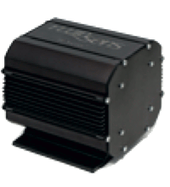
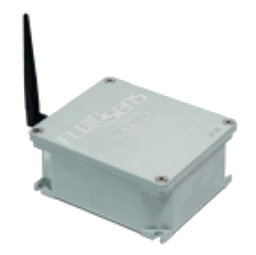
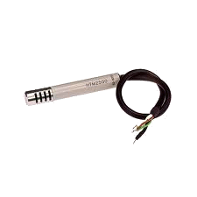
The FLUIDSENS™ architecture

Slide 7
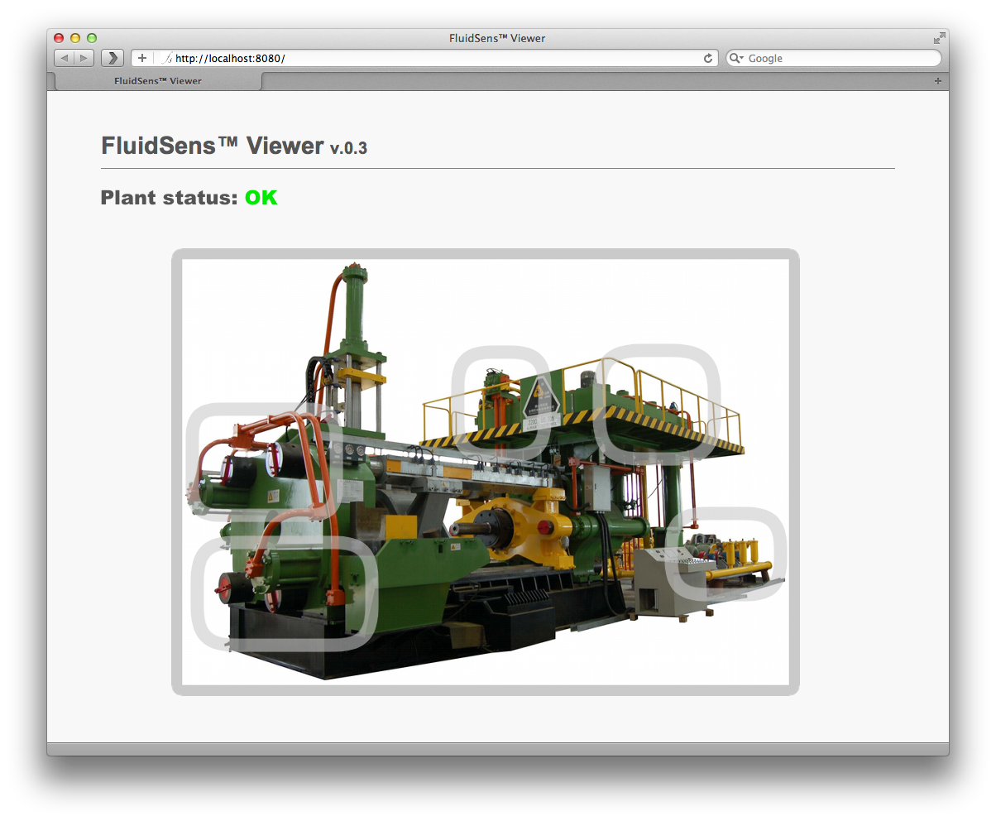
FLUIDSENS™ in action
Sections that have been sensored by Fluidsens can be zoomed in for more details
Photographic representation of actual plant helps visualizing status information

Slide 8
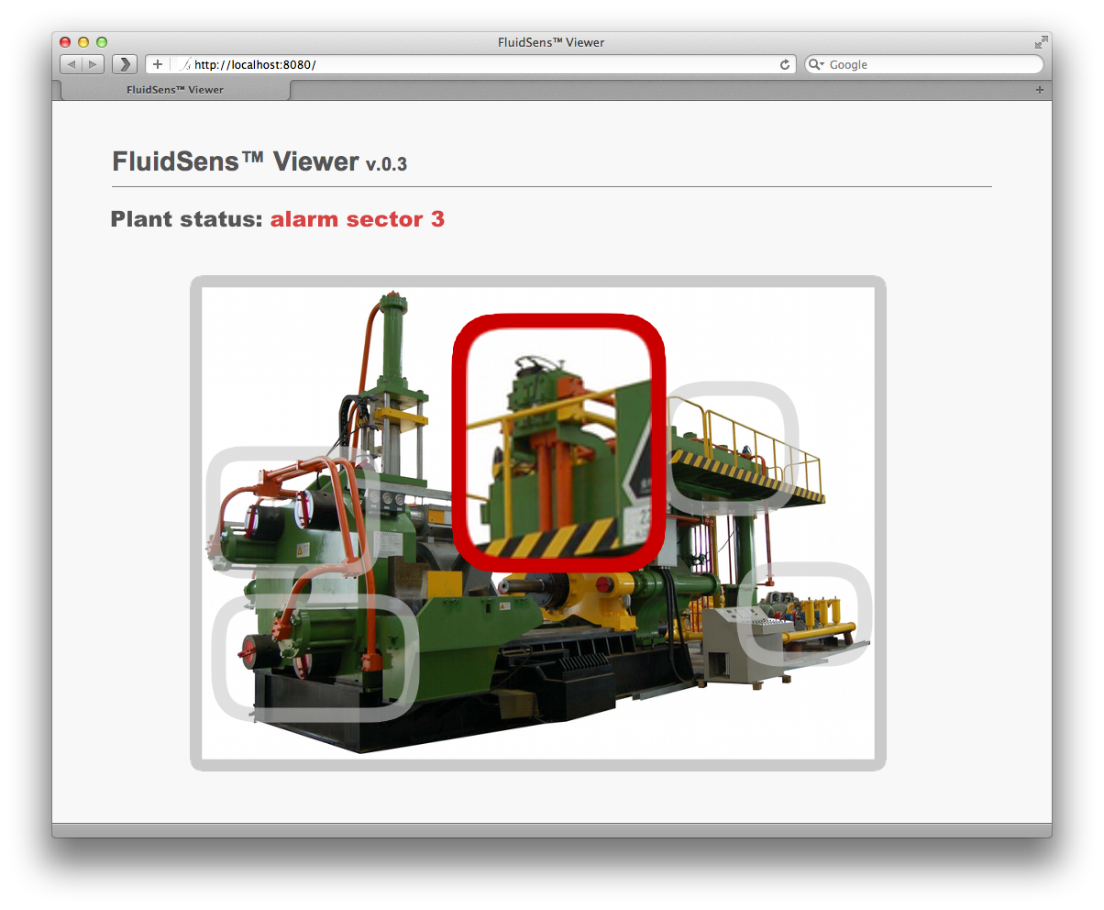
FLUIDSENS™ in action
Alarms (preventive maintenance, faults, etc.) are instantaneously signaled. Clicking on an alarmed section will make the viewer visualize historic data on it, underlining where the problem is.
Clicking on each section brings up real-time and historic sensory data details

Slide 9
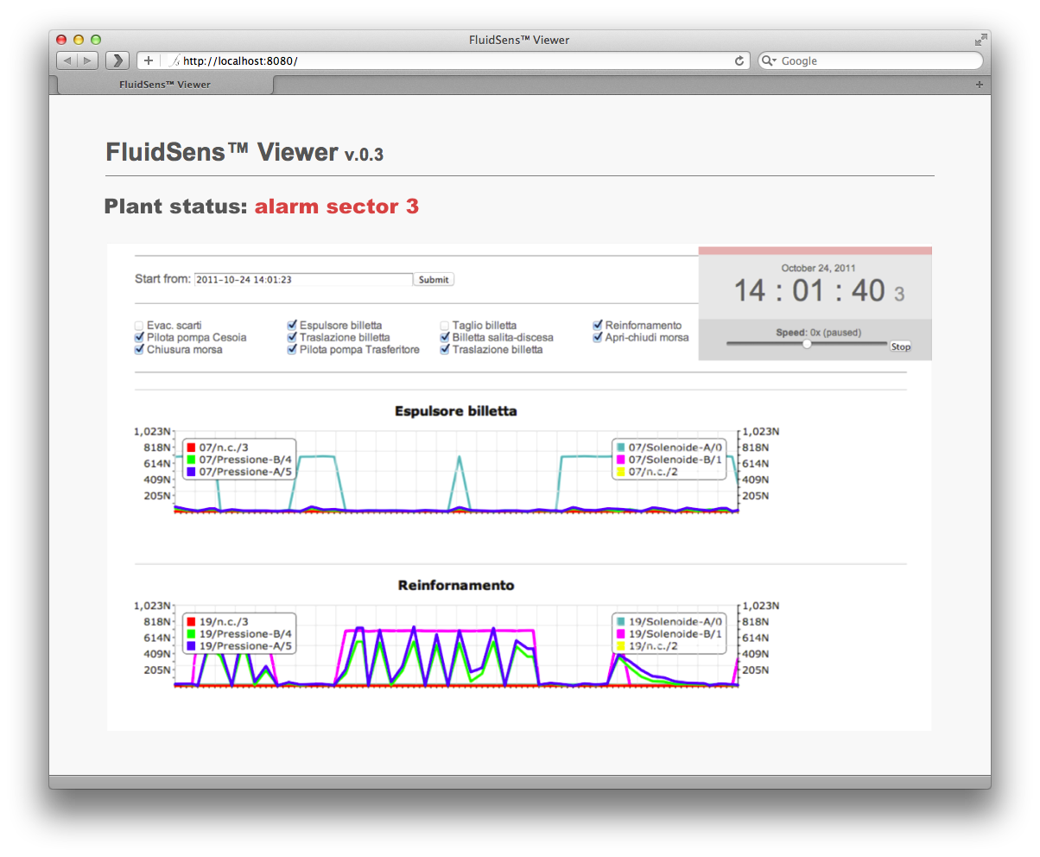
FLUIDSENS™ in action
A recording of what caused the alarm is readily accessible. Data can be “replayed” in slow motion, with fast-forward, rewind, zoom operations.

Slide 10
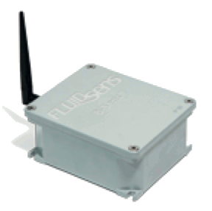
The B-Sens
The leaf of our architecture: it “senses” the status of any sensor on six independent channels
Built with industrial-class technology
Strong aluminum-alloy, IP67 enclosure
Xbee, industrial-class wireless electronics, protected by AES encryption
Vibration and shock-resistant
Works up to 75 deg. C
Two monitoring inputs for electrical valves
Based on proprietary HW and SW
10-bit A/D HW converter
Sampling up to 10 samples/sec
Resilient SW architecture
Proprietary, low energy wireless transmission protocol
Four monitoring inputs for ANY type of voltage/current sensor:
temperature
power consumption
pressure
flow
…
One B-Sens can be attached to ANY sensor, in ANY location on your plant, and is low cost enough to cover thousands of sensors per plant

Slide 11
The H-Sens
The “Hub” of B-Senses
Based on standard SBC platform
Real-time collector: It can collect real time-data of dozens of B-Senses, positioned 10’s of meters away
Standalone mode:
on small plants it can also act as a viewer interacting with customer’s IT infrastructure
Scalable architecture: on large plants, multiple H-Sens cooperate to become a single virtual H-Sense

Slide 12
The FLUIDSENS™ Viewer
Access to all plant’s vital statistic
Up to multiple years of recording, if needed
Correlation between data coming from multiple sensors
Real time and/or historic data

Slide 13
The FLUIDSENS™ advantage
Monitoring “only”: it overlays on existing plant automation HW and SW, without disturbing them
Extremely versatile and scalable architecture…
Can be adapted to sense any type of plant or apparatus
…built on industrial-grade components to withstand rough industrial environments
A revolutionary enabling platform for existing plants:
Fault detection
Threshold-based
Artificial Intelligence (A.I.)-based
Cycle optimization
Preventive maintenance: enables action before faults happen
A base for energy saving optimizations
An open platform that can be completely customized based on each customer’s needs

Slide 14
Conclusions: ready for a trial
FLUIDSENS™ is a revolutionary architecture that allows low-cost retrofitting of existing plants to bring them to the 21st century
Preventive maintenance
Energy saving
Cycle optimization
Automated alarm system
Photo-based interface: customized for each customer’s needs
AI-based system allows recording each plant’s regular operation, and will constitute the baseline over which faults are signaled: manual setup is minimized
The FLUIDSENS™ platform is now available
Interested customers can sign up for testing our products

Slide 15
Lesson learnt
Big production companies have big inertia and big hierarchies (a project that can be approved from technical staff, can be delayed by purchasing managers - and vice-versa)
It's nearly impossible to obtain a public funding for the start-up companies in this period: the benefits offered by the government are just related to tax reliefs, so the companies have to bill before asking benefits, and this could be a limit for start-ups.

Slide 16
The gory details…
Wireless
Built on Xbee industrial wireless modules: highly resistant to interference, very low power, does not disturb existing installation, enables 10’s of meters operation (from the H-Sense) even in very congested, metallic dense environments
Worldwide compatibility and certification
ISM 2.4 GHz band (worldwide)
Snap-in replacement module for specific requirements:
900 MHz Americas
Other frequencies (rest of the world)
Serial (cabled) 465 upon request
Power
B-sens: 12VDC, 1A max
H-sens: 24VDC, 2A max
System supplied with universal 110/220 AC/DC power supply
Installation
Can be performed by in-house technicians, with Fluidsens’ personnel directives
Can be performed by Fluidsens’ personnel

